Slide 1
Tales from the .NET 8 Migration Trenches
Jimmy Bogard

Slide 2


Tales from the .NET 8 Migration Trenches
Jimmy Bogard
@jbogard
github.com/jbogard
jimmybogard.com

Slide 3
Me Junk
Independent Consultant
@jbogard
github.com/jbogard
jimmybogard.com

Slide 4
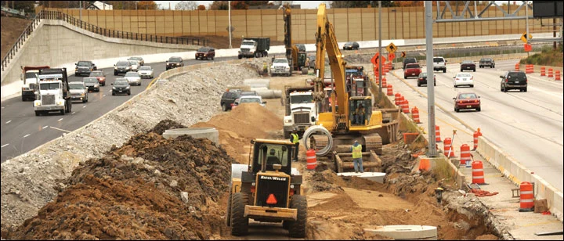
Migration Strategy

Slide 5
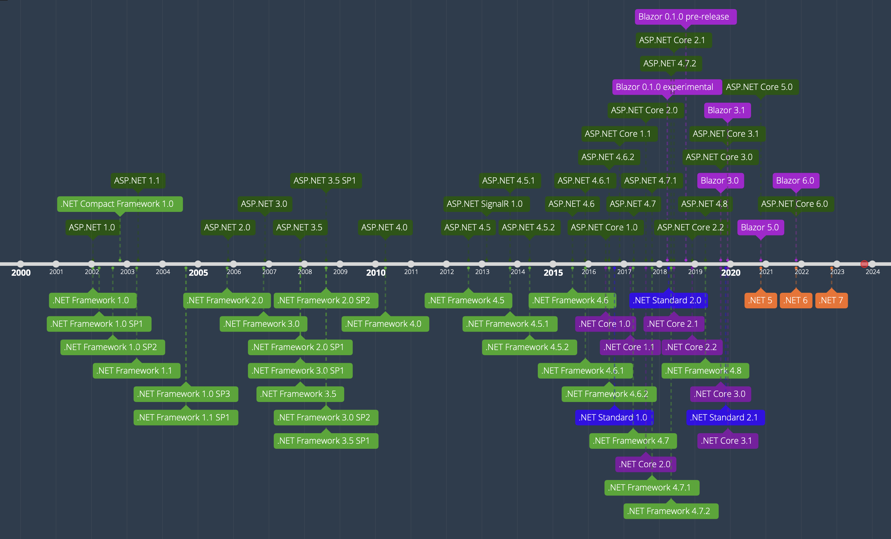

Slide 6
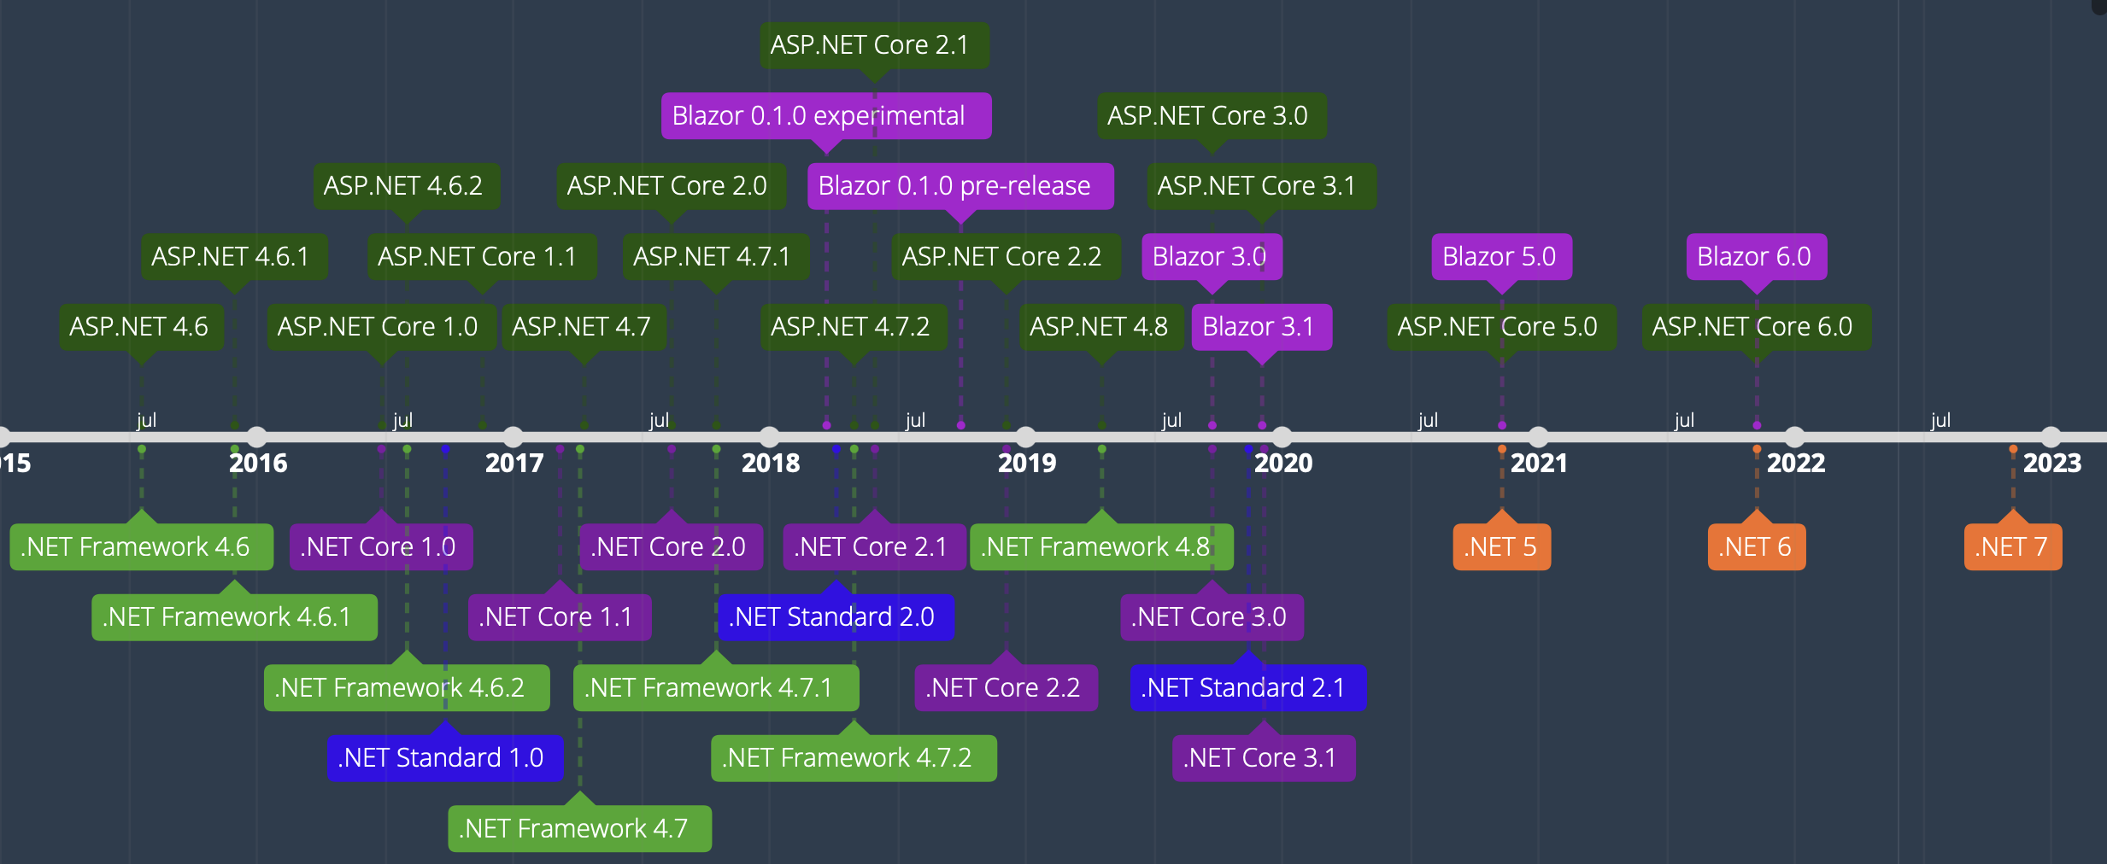

Slide 7
Cataloging

Slide 8
Application Survey
MVC HTTP endpoints (MVC and API controllers/actions)
Non-MVC HTTP endpoints (ASPX, ASHX, etc)
ASP.NET MVC middleware
ASP.NET middleware (web.config etc)
Library Dependencies
Component Dependencies

Slide 9
Sample Application
ASP.NET MVC 5 w/ Razor
SignalR
Session
Hangfire
“State of the Art” circa 2010

Slide 10
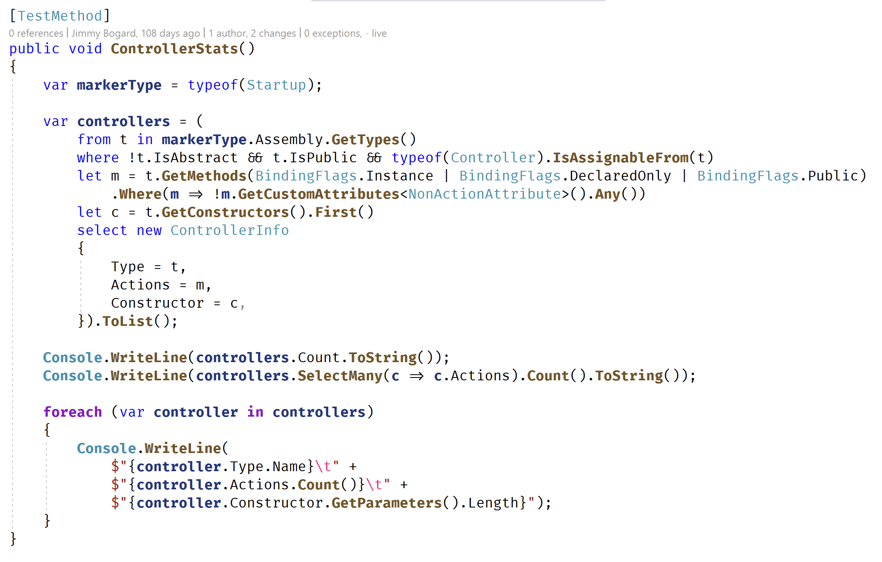
MVC HTTP endpoints Inventory

Slide 11
MVC HTTP endpoints Inventory
Controllers: 6
Actions: 58
Controller | Actions | Ctor Args
ContosoUniversity.Features.Department.UiController | 8 | 1
ContosoUniversity.Features.Student.UiController | 8 | 3
ContosoUniversity.Features.Instructor.UiController | 8 | 1
ContosoUniversity.Features.Home.UiController | 4 | 1
ContosoUniversity.Features.Course.UiController | 8 | 3
ContosoUniversity.Features.Account.UiController | 22 | 0

Slide 12
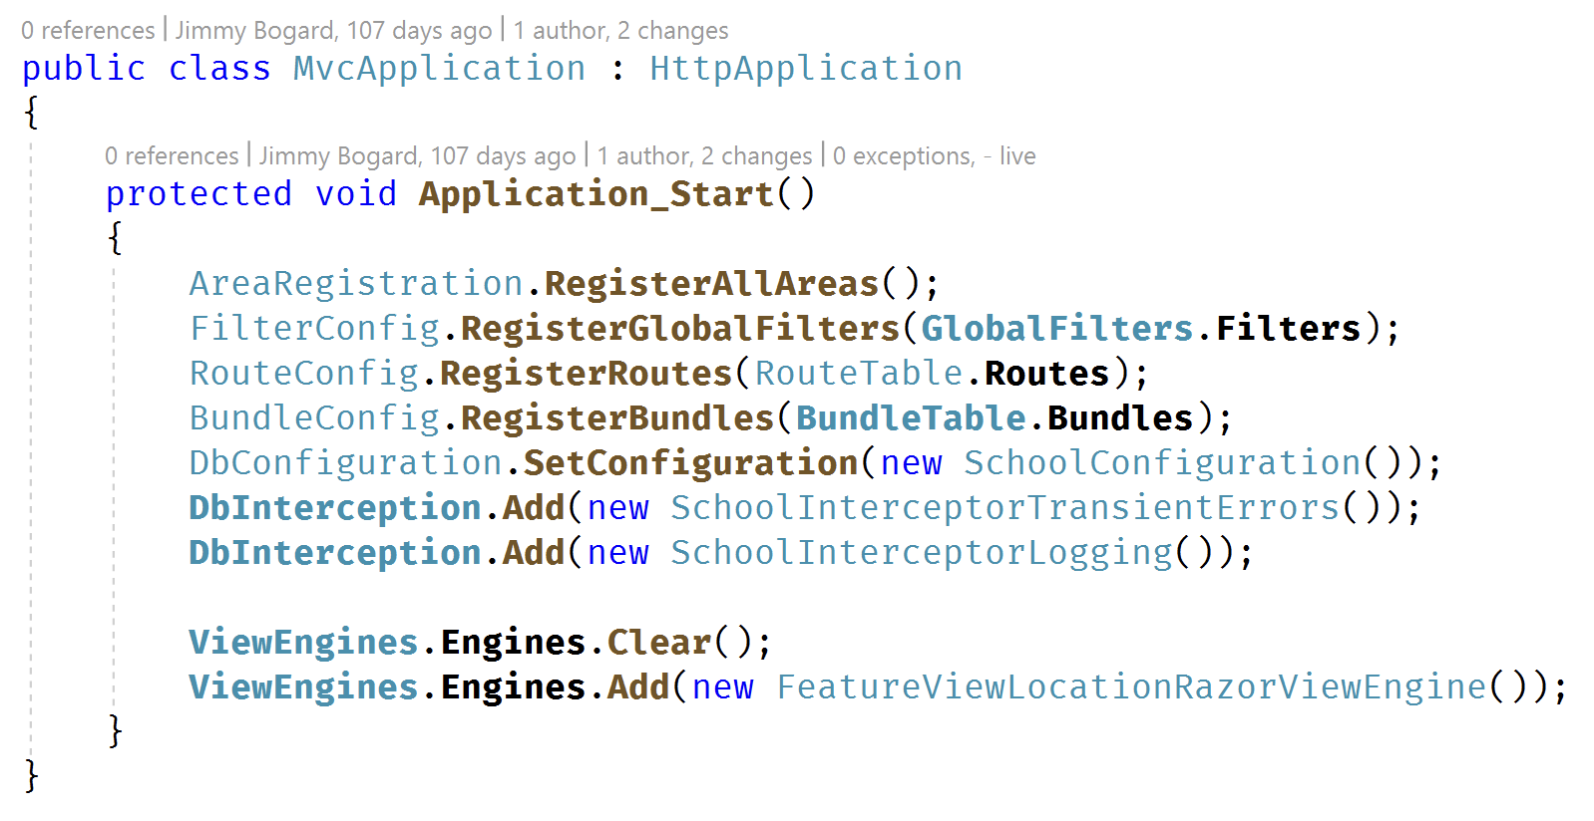
ASP.NET MVC Features and Middleware

Slide 13
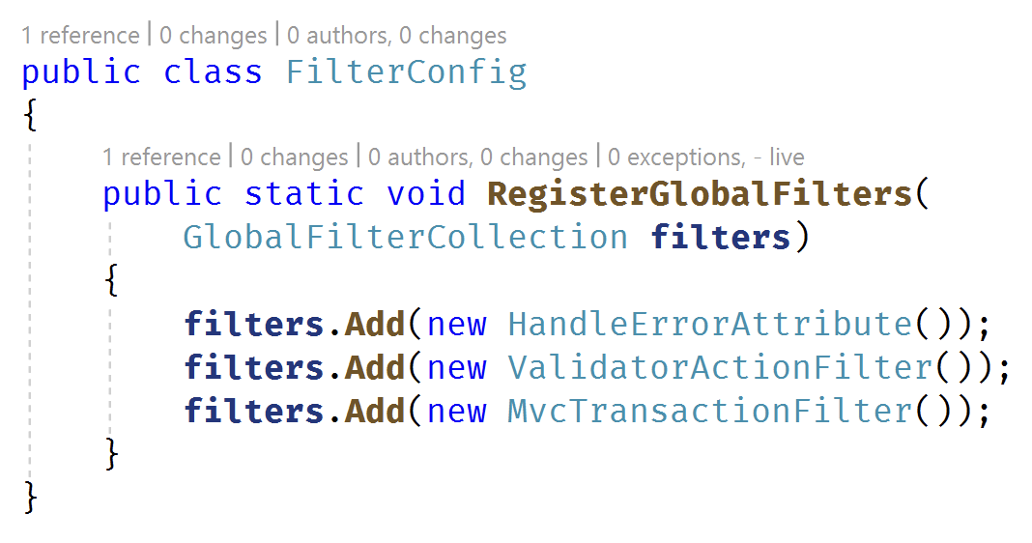
ASP.NET MVC Middleware

Slide 14
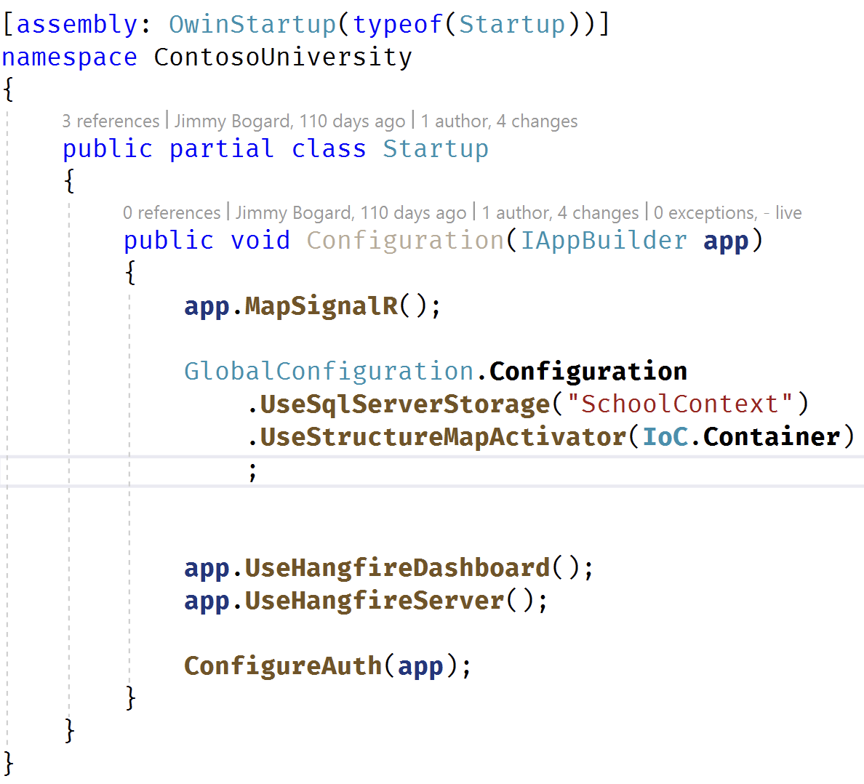
OWIN Middleware

Slide 15
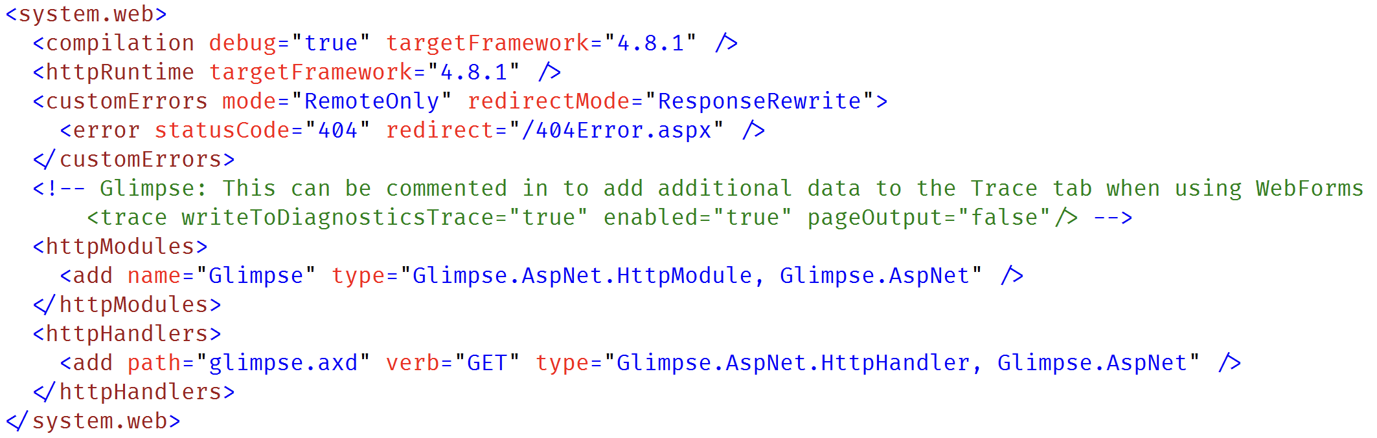
ASP.NET Middleware

Slide 16
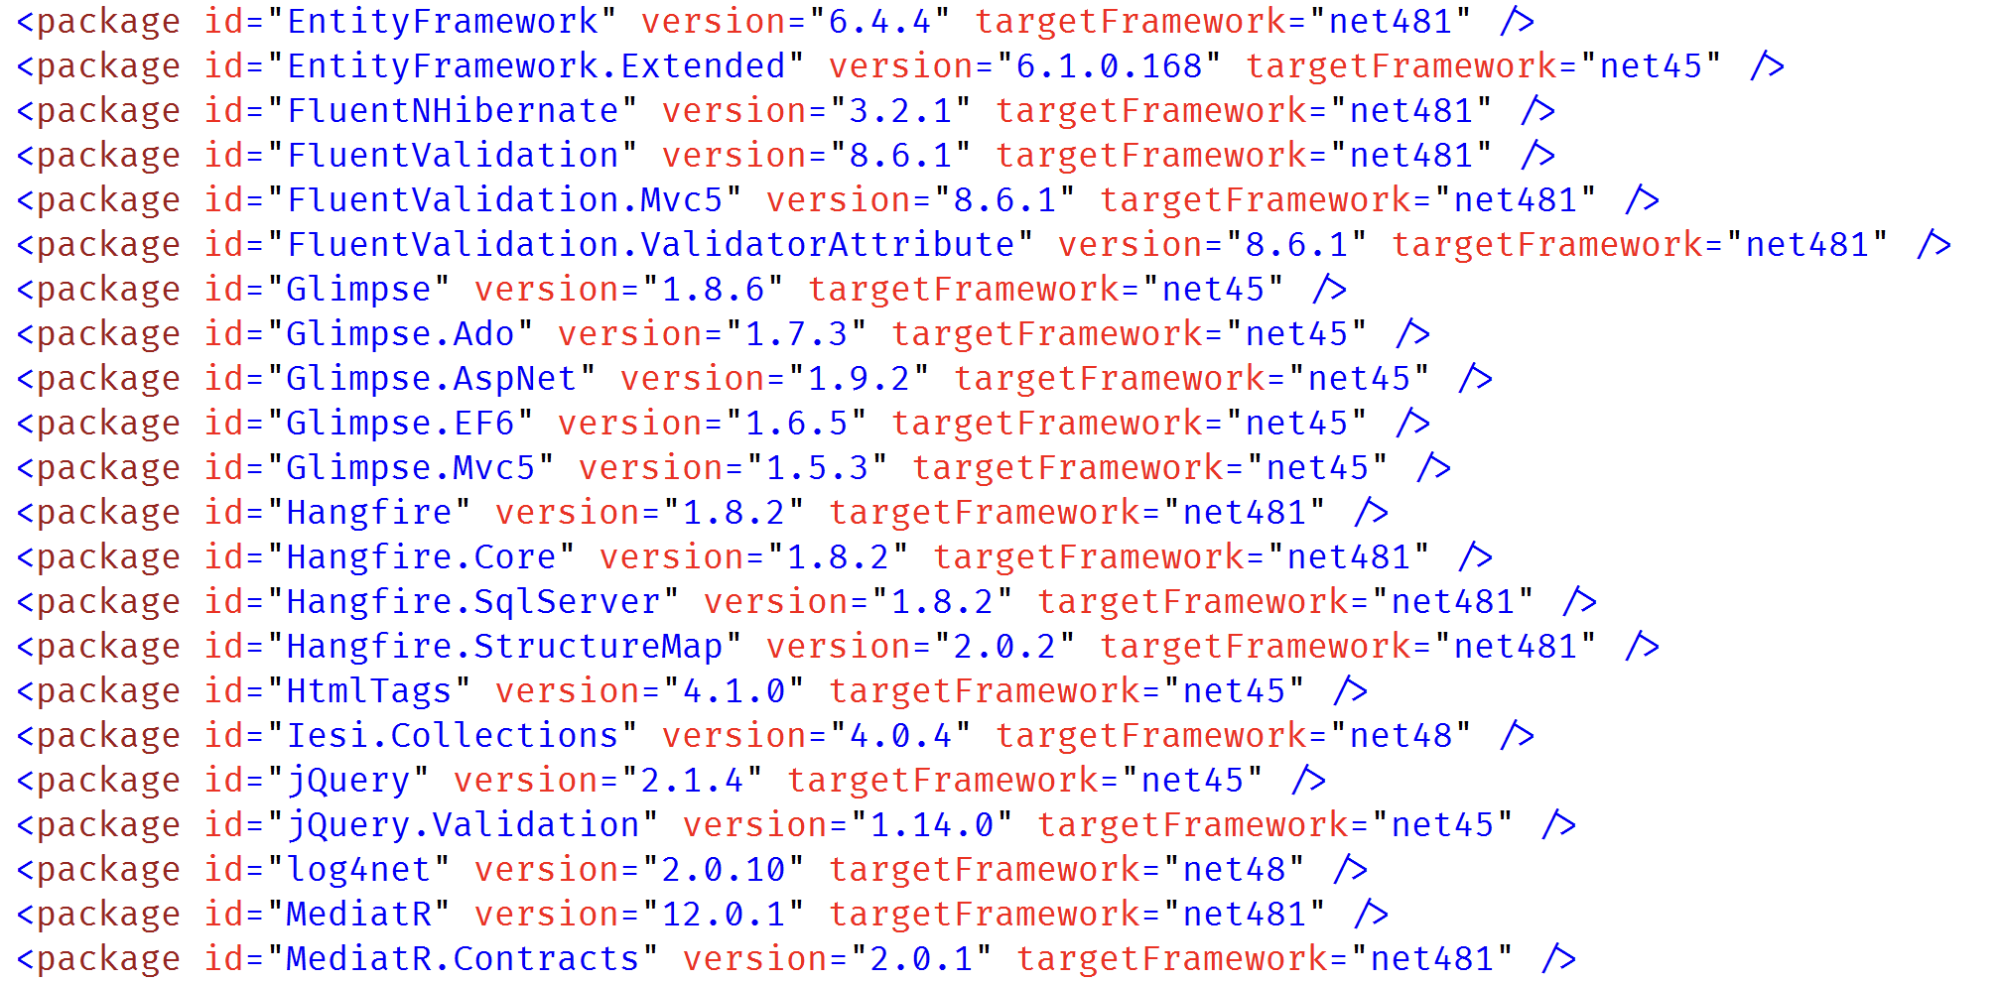
Dependencies

Slide 17
System.Web Adapters

Slide 18
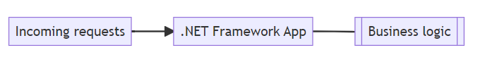
System.Web Adapters

Slide 19
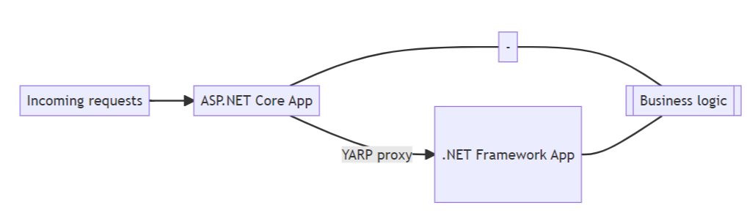
System.Web Adapters

Slide 20
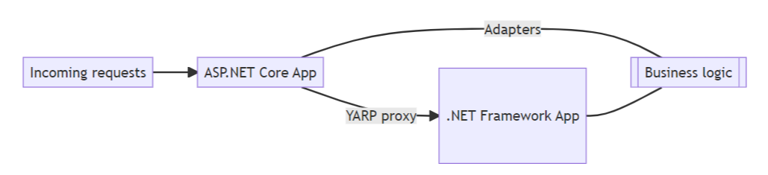
System.Web Adapters

Slide 21
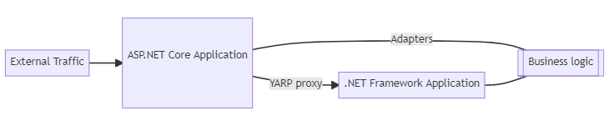
System.Web Adapters

Slide 22
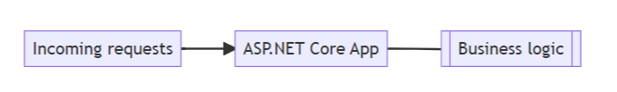
System.Web Adapters

Slide 23
Demo: .NET Upgrade Assistant

Slide 24
First Step: Empty Proxy

Slide 25
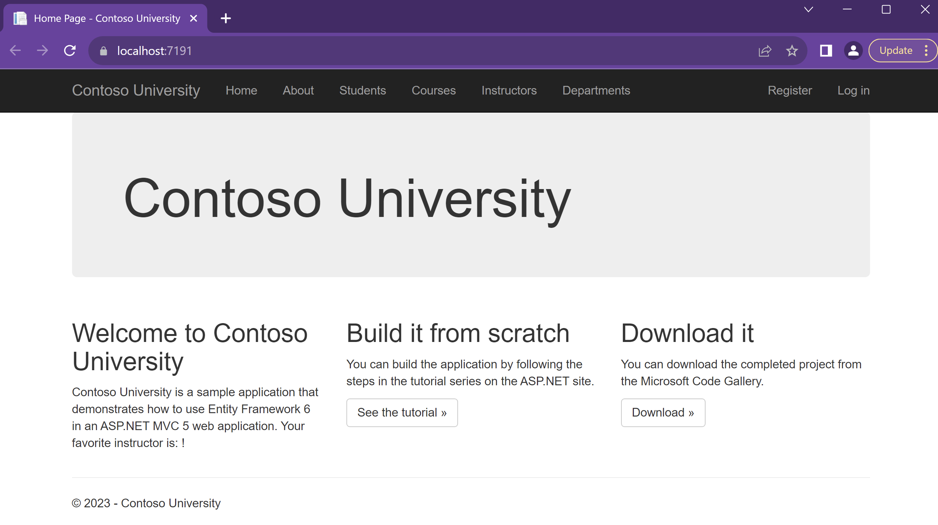
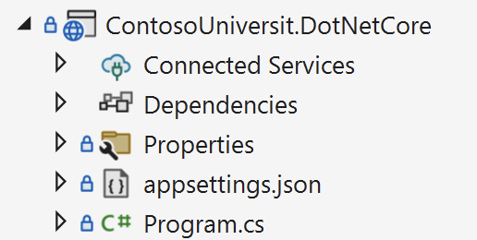
Empty Proxy

Slide 26
Next Step: Shared Library
ASP.NET 4.8 MVC 5
ASP.NET
Core 8

Slide 27
End Goal
Shared Library
ASP.NET 4.8 MVC 5
ASP.NET
Core 8

Slide 28
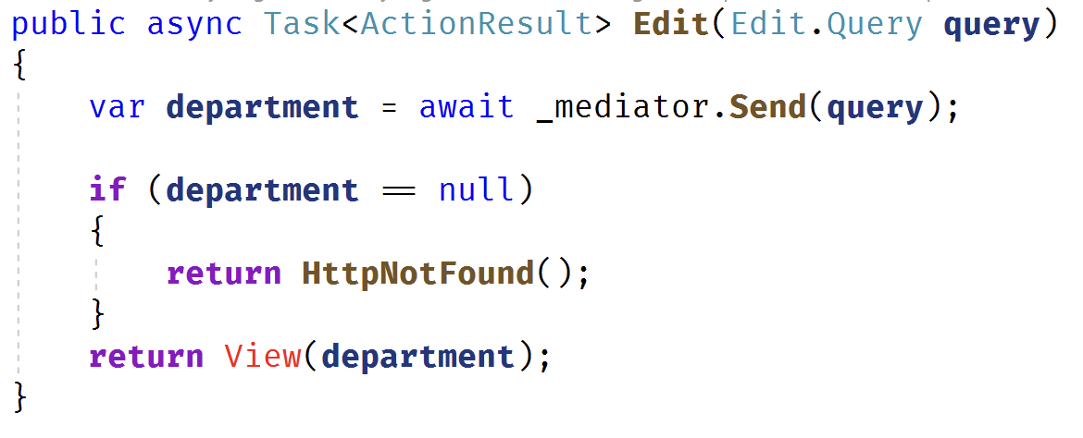
What to Share?
Data models
EF Core models
Domain model
Business Logic
Services
Helpers
Handlers
Any non-UI code

Slide 29
Target Framework(s)
netstandard2.0
Can multi-target if required
.NET 4.8
.NET 8

Slide 30
Dependency Upgrade
DEPENDENCY | CURRENT VERSION | TARGET VERSION
Antlr4 | 3.5.0.2 | 4.6.6
AutoMapper | 5.1.1 | 10.1.1
AutoMapper.EF6 | 0.5.0 | 2.1.1
DelegateDecompiler | 0.18.1 | 0.32.0
DelegateDecompiler.EntityFramework | 0.18.1 | 0.32.0
EntityFramework | 6.1.3 | 6.4.4
FluentNHibernate | 2.1.1 | 3.2.1
FluentValidation | 6.2.1.0 | 8.6.1
FluentValidation.Mvc5 | 6.2.1.0 | 8.6.1
MediatR | 2.1.0 | 12.0.1
NHibernate | 5.2.5 | 5.3.3

Slide 31
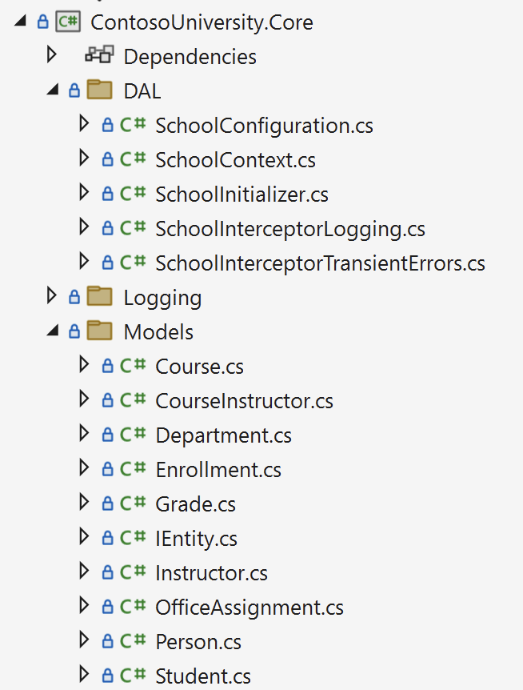
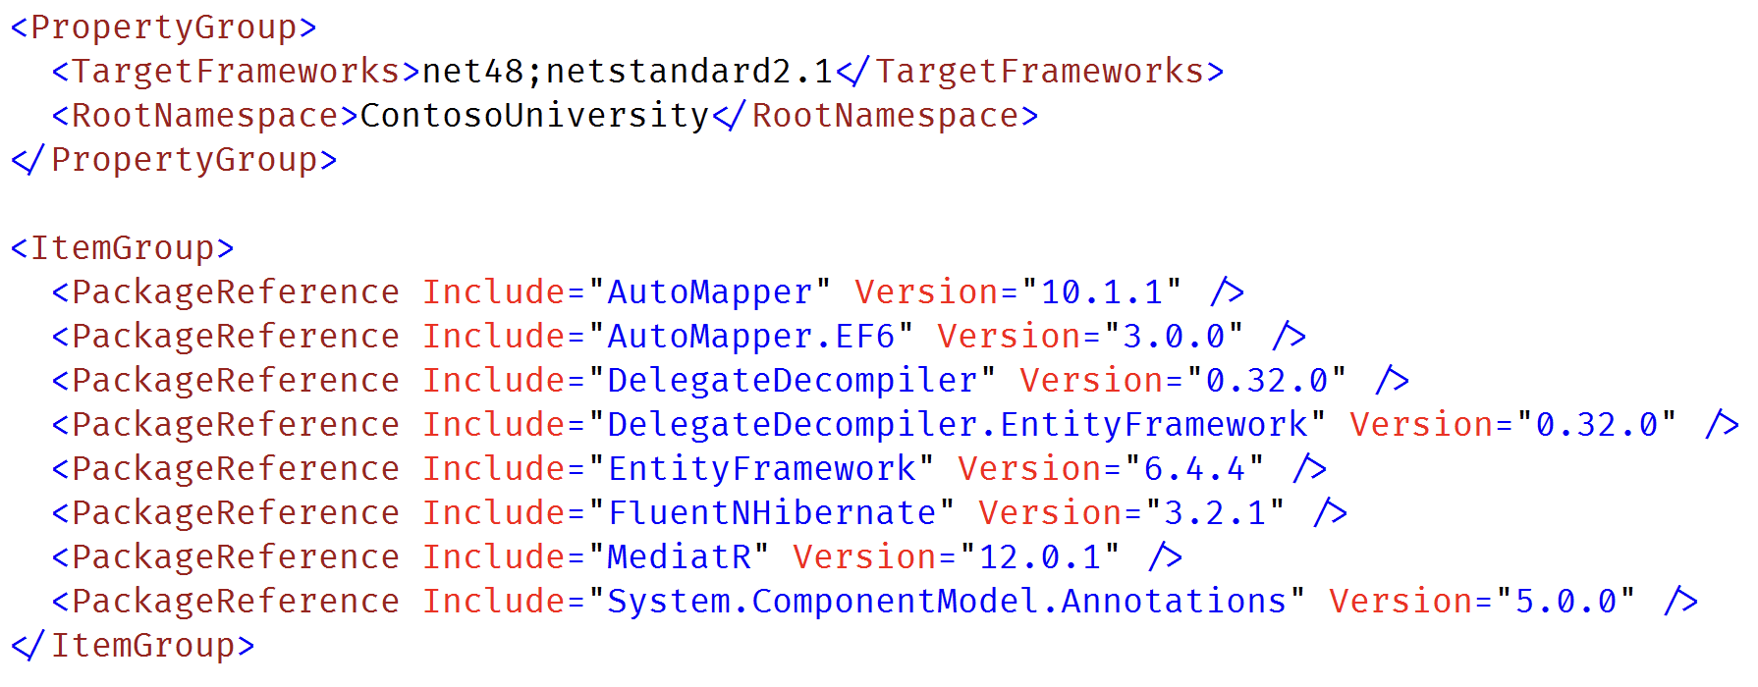
Final Result

Slide 32

First Controller

Slide 33
Meh Demo

Slide 34
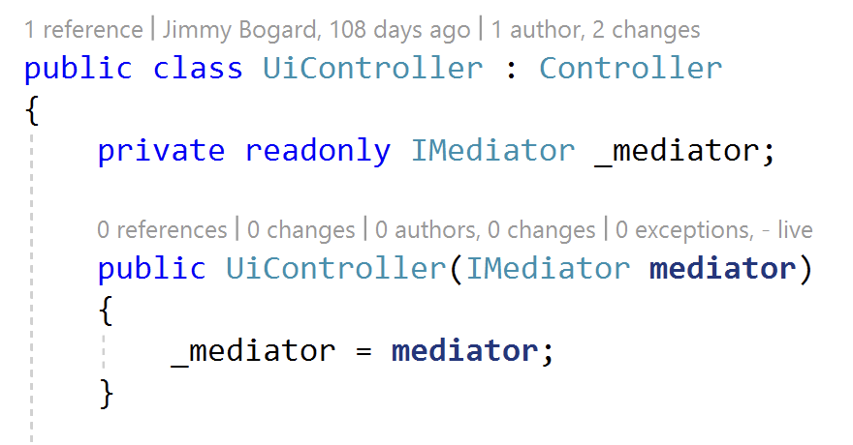
Controller Migration

Slide 35
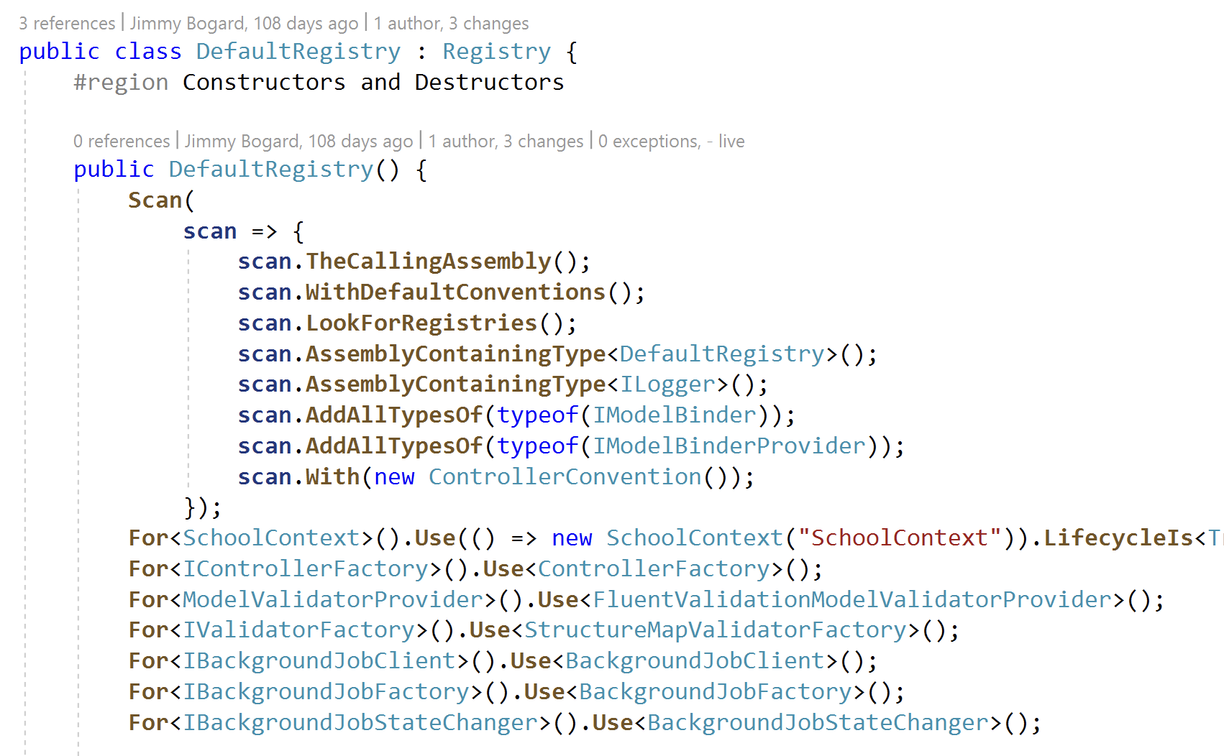
Dependency Injection
Kinda there in ASP.MVC “Classic”
Will likely require migration
Not really worth trying to share
Stock container may not be possible

Slide 36
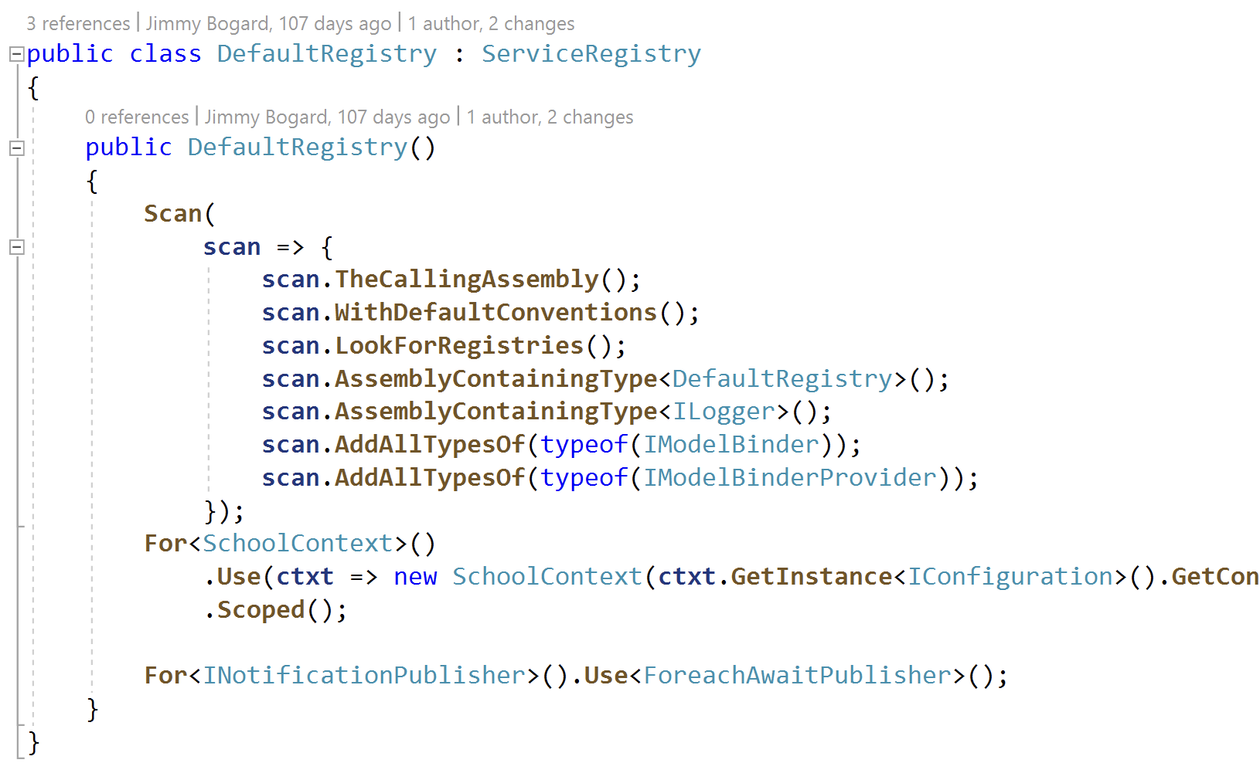
Dependency Injection

Slide 37
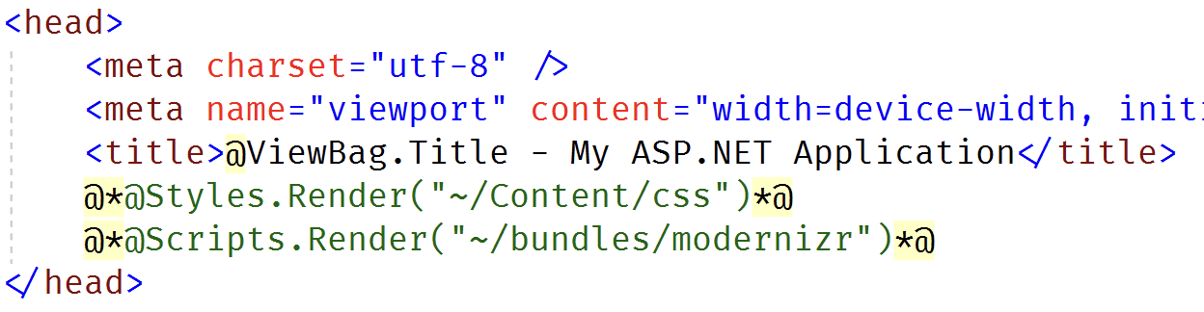
View Migration

Slide 38
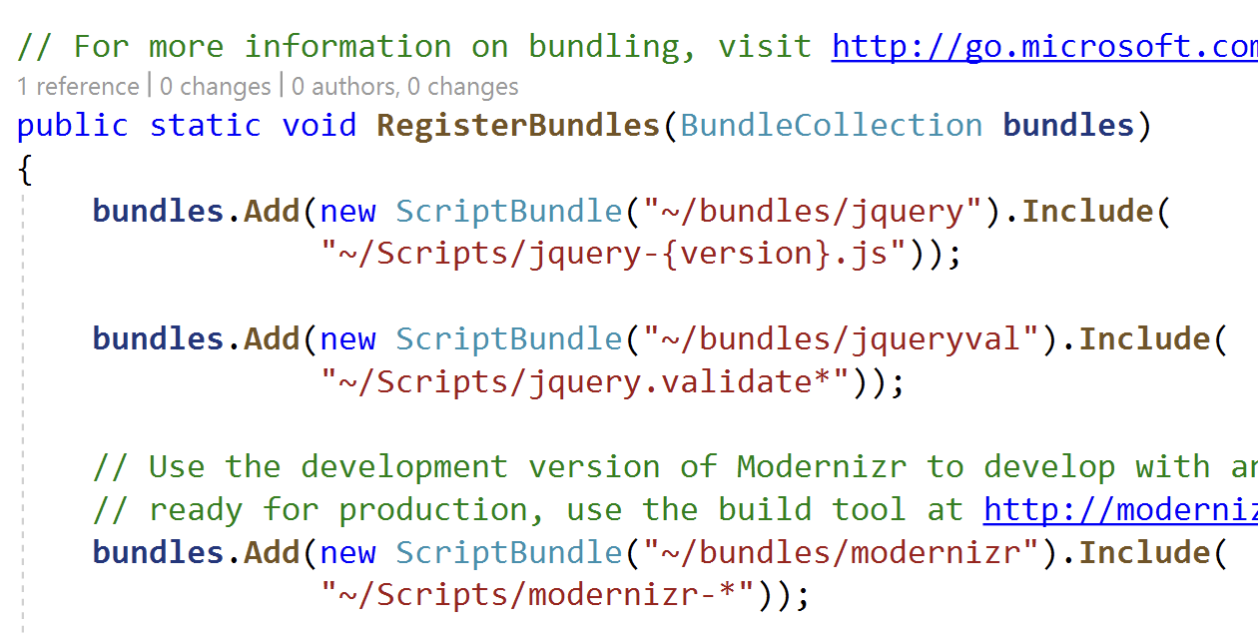
ASP.NET MVC 5 Bundling

Slide 39
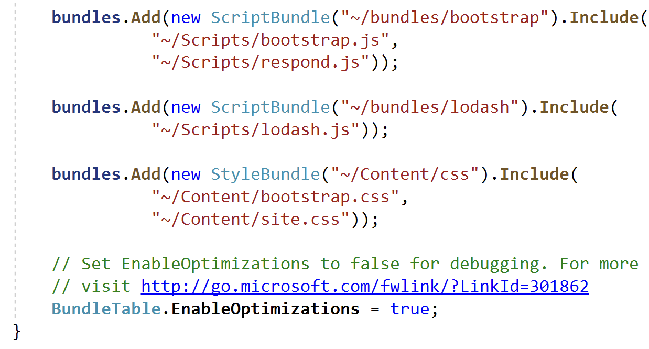
ASP.NET MVC 5 Bundling

Slide 40
ASP.NET Core Bundling Options
OSS library (WebOptimizer)
Similar to ASP.NET MVC 5
But not EXACTLY the same (not a drop-in replacement)
URLs and options differ
External node.js tool
Webpack etc.
New tool and new build pipeline
May not be compatible with existing libraries
May not be compatible with control/component libraries

Slide 41
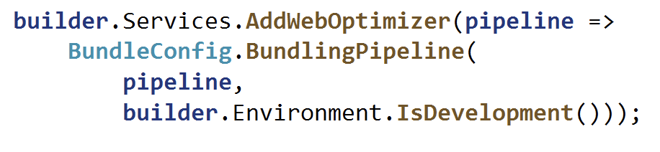
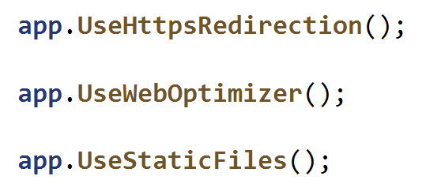
WebOptimizer

Slide 42
Dual Bundling Pipelines
Legacy requests use legacy pipeline
.NET 8 requests use new pipeline
Static assets are shared between both
Do not want to duplicate code
ASP.NET
Core 8
Bundle
ASP.NET 4.8 MVC 5
Bundle

Slide 43
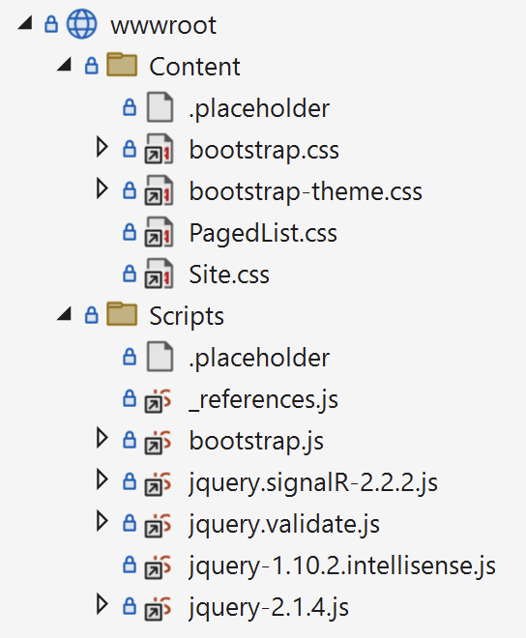
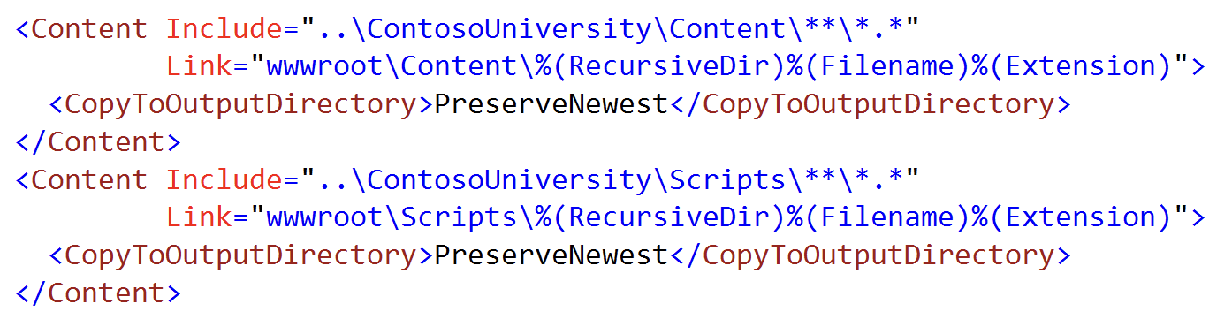
Avoiding Asset Duplication

Slide 44
Typical MVC Slice Migration
Copy Controller
Correct namespaces
Migrate any filters used
Copy business logic and models
Pull in any packages needed
Make sure controllers also compiles
Copy views
Pull in any HtmlHelper extensions and correct
Convert child actions to view components
Delete ASP.NET MVC code

Slide 45
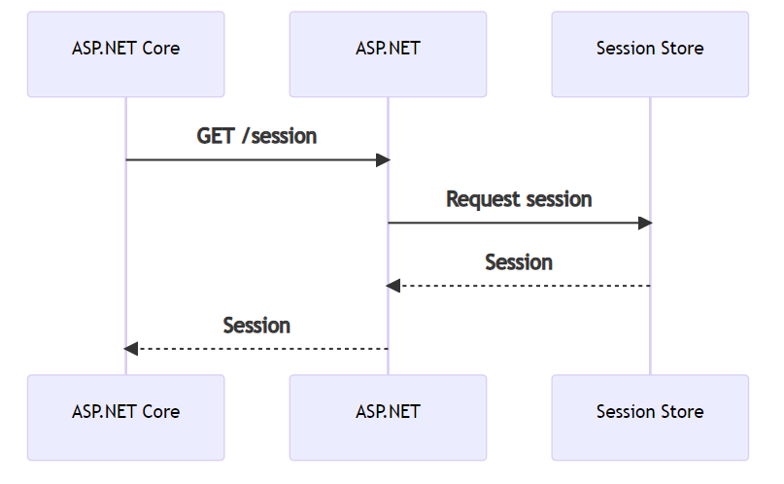
Session (ugh)

Slide 46
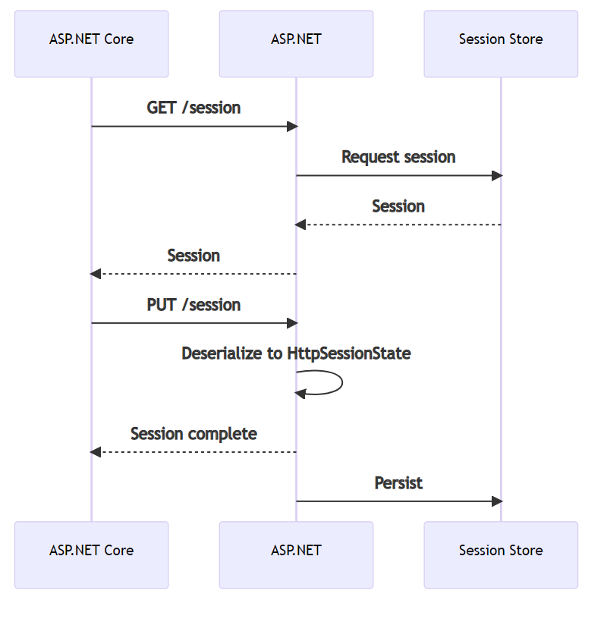
Session (ugh) (cont.)

Slide 47
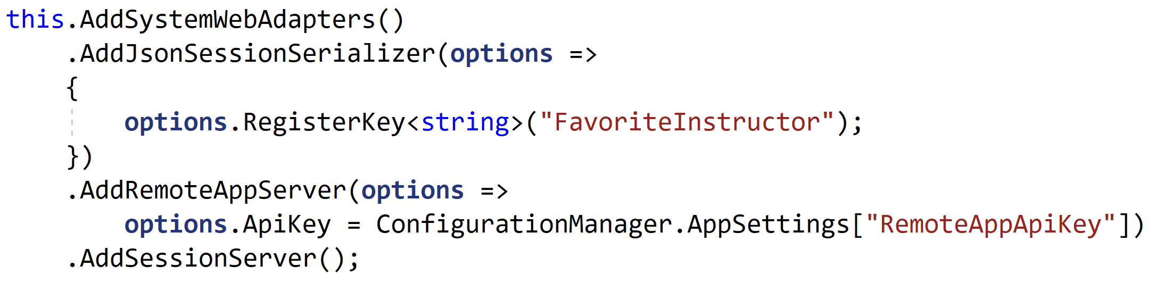
ASP.NET MVC 5 Configuration

Slide 48
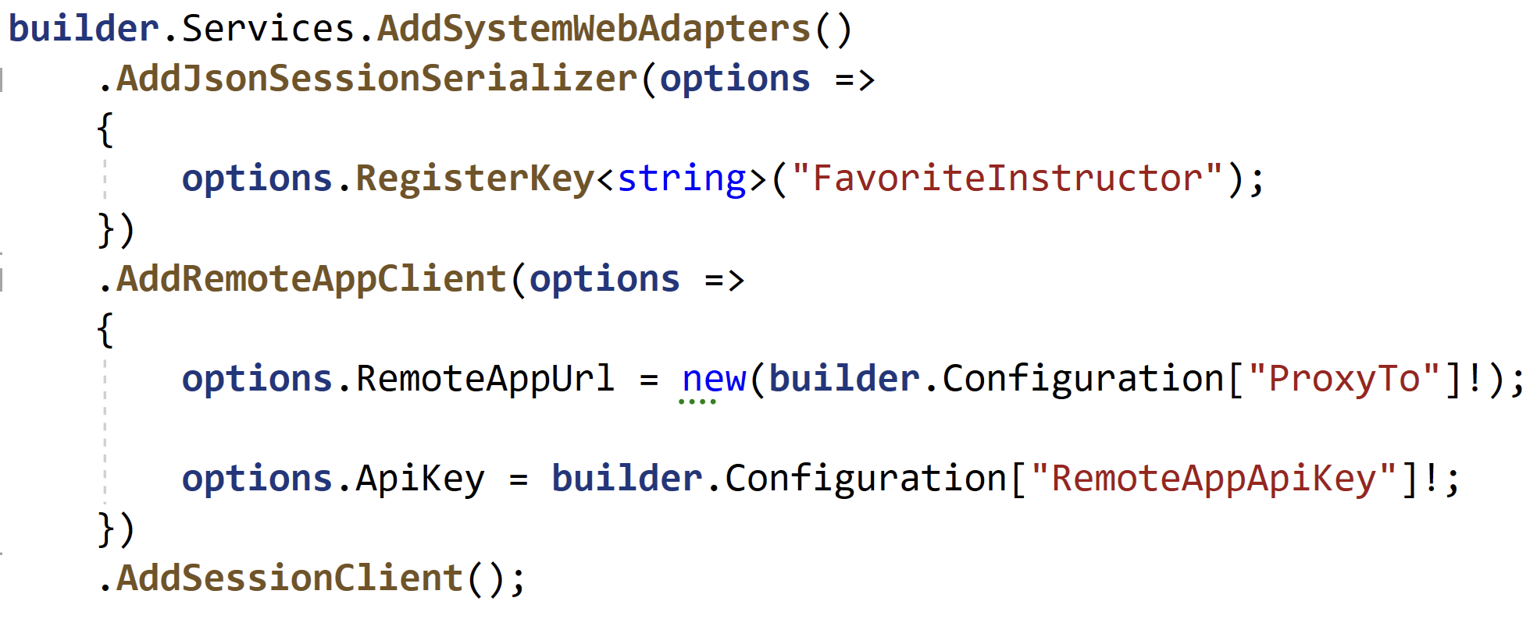
ASP.NET Core Configuration

Slide 49
Session Options
ASP.NET Session and ASP.NET Core Session quite different
Transparent vs. explicit serialization
Locking
Persistence options
Wrapped ASP.NET Core session
Adapters can use ASP.NET Core session
Good for shared code migrating session
Remote App Session State
Explicitly call to remote app for session state
Standalone session state

Slide 50
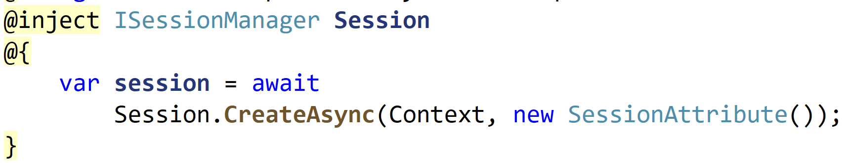
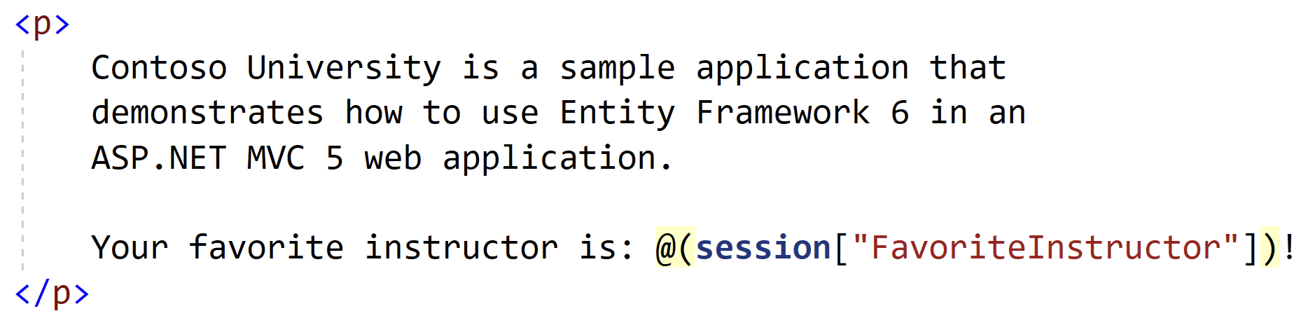
Remote Session App Usage

Slide 51
Hangfire
Job scheduling and queueing extension
Supports both ASP.NET 4.x and ASP.NET Core
Persistence of jobs is also cross-platform
Supports multiple queues
Do NOT want work to be duplicated
Jobs can exist in any .NET library

Slide 52
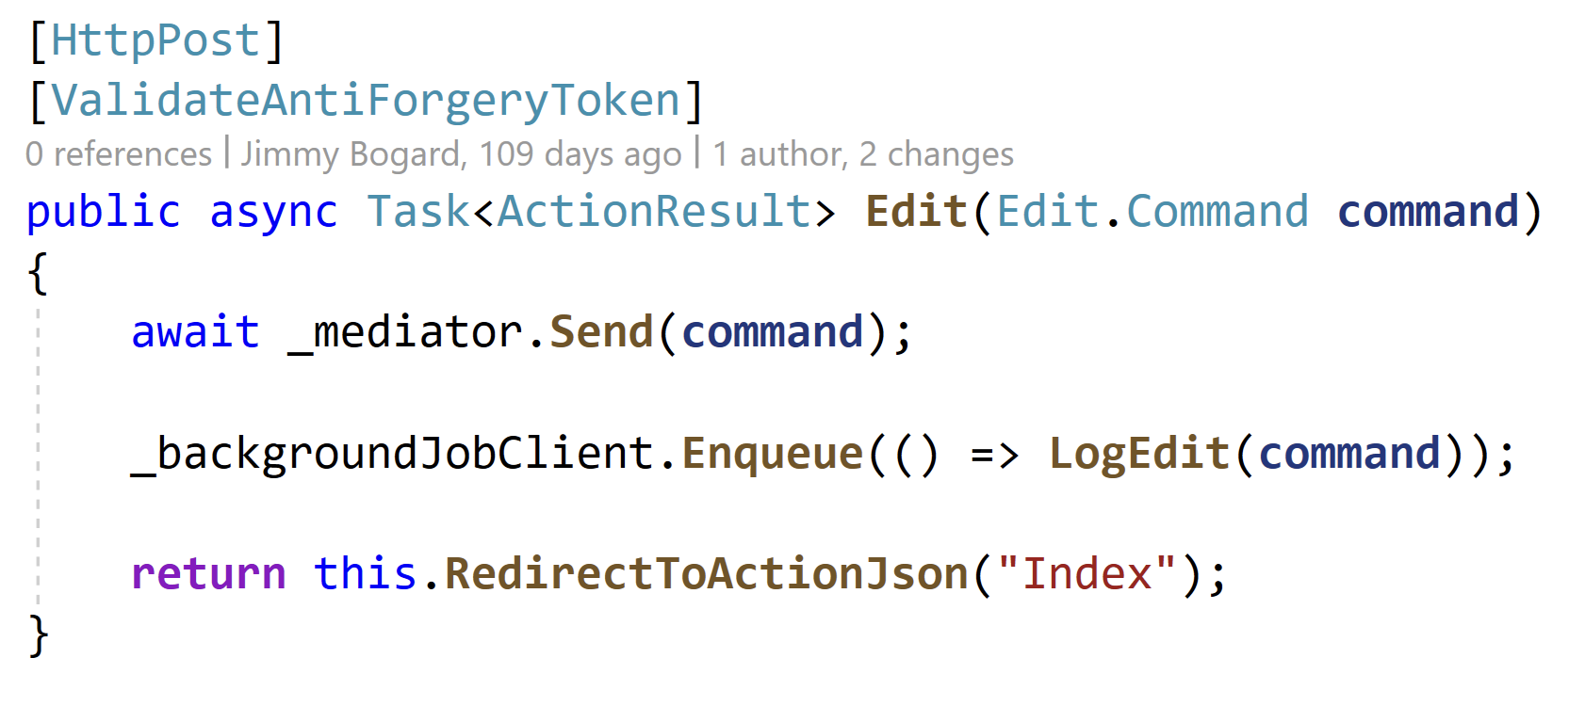
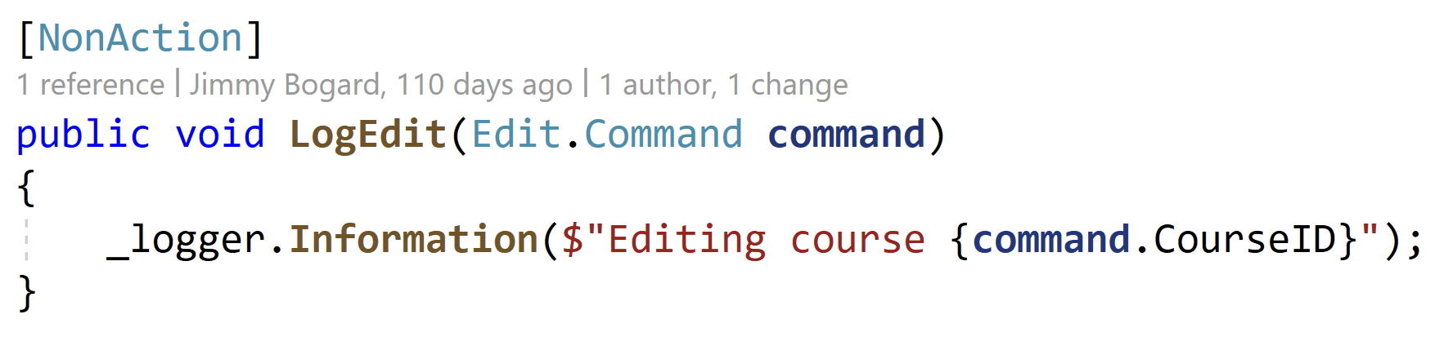
Hangfire Usage

Slide 53
Hangfire Job Execution
ASP.NET
Core 8
Queue: default-core
ASP.NET 4.8 MVC 5
Initiator: .NET 8
Job: .NET 8
DB
Queue: default-core

Slide 54
Hangfire Job Execution
ASP.NET
Core 8
Queue: default
ASP.NET 4.8 MVC 5
Initiator: .NET 8
Job: .NET 4.8
DB
Queue: default

Slide 55
Hangfire Job Execution
ASP.NET
Core 8
Queue: default-core
ASP.NET 4.8 MVC 5
Initiator: .NET 4.8
Job: .NET 8
DB
Queue: default-core

Slide 56
Hangfire Job Execution
ASP.NET
Core 8
Queue: default
ASP.NET 4.8 MVC 5
Initiator: .NET 4.8
Job: .NET 4.8
DB
Queue: default

Slide 57
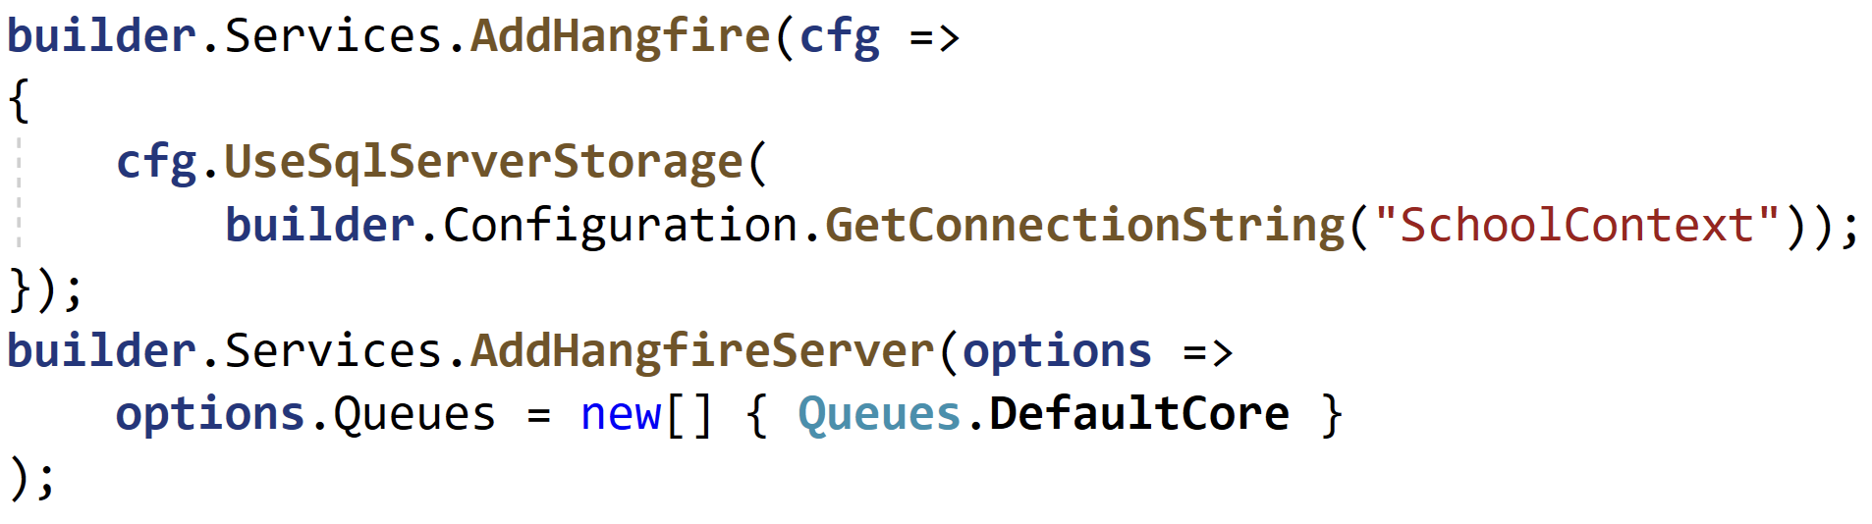
Hangfire Configuration

Slide 58
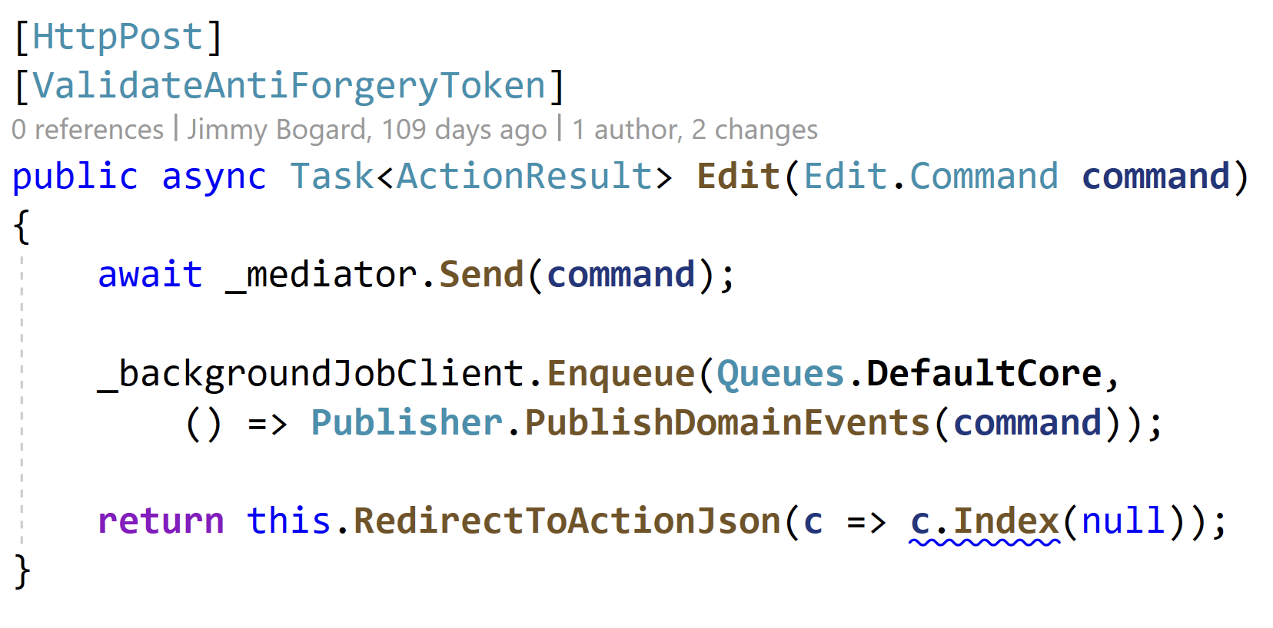
Cross-App Queueing

Slide 59
Authentication Options
Highly dependent on authentication scheme
Cookie auth can be shared
Effectively SSO with cookies
Sign in/out with either app
Need to have matching data protection settings
Remote authentication
Similar to shared session
API calls to ASP.NET MVC 5 application to populate identity

Slide 60
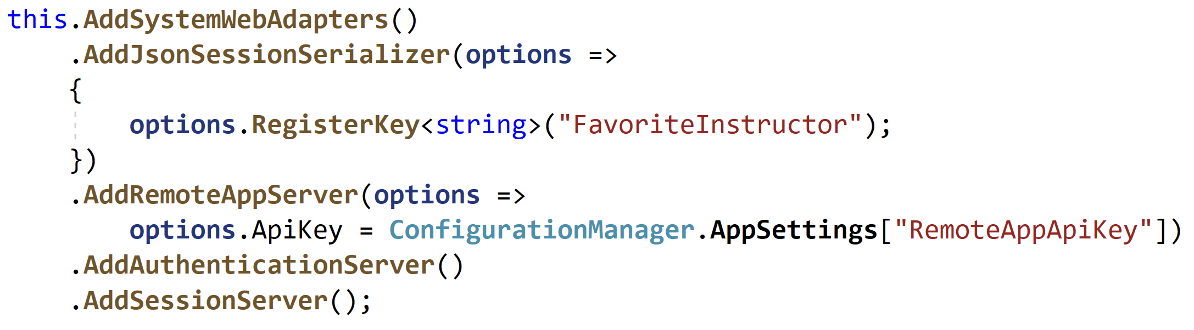
Configuring Authentication

Slide 61
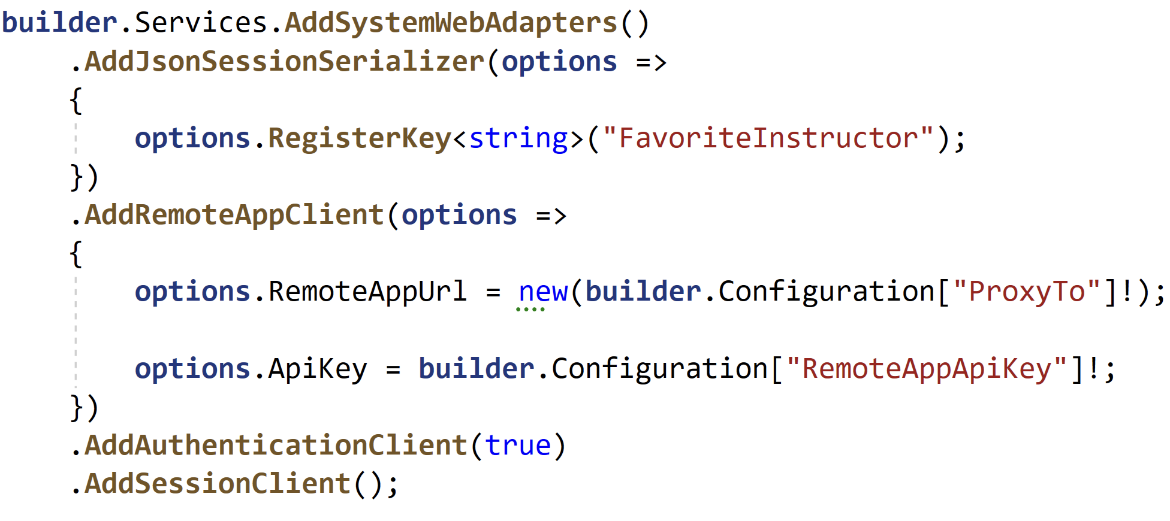
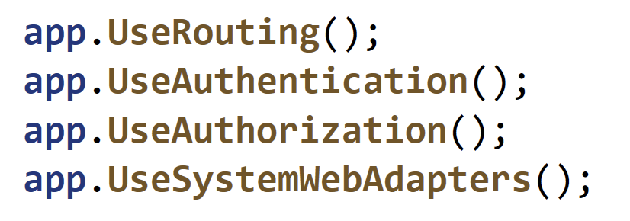
Configuring Authentication

Slide 62
Migrating Middleware
ASP.NET/IIS Middleware
Most have equivalents in ASP.NET Core
Most will be in web.config
But can be in app.config or machine.config or directly in IIS
ASP.NET MVC Middleware
Some may workaround limitations
Some may not be needed
All should be evaluated

Slide 63
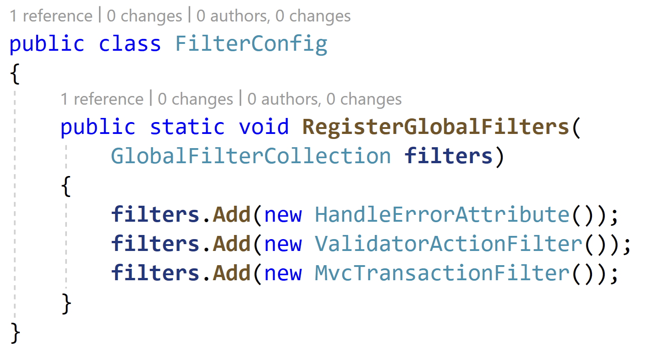
Current Middleware

Slide 64
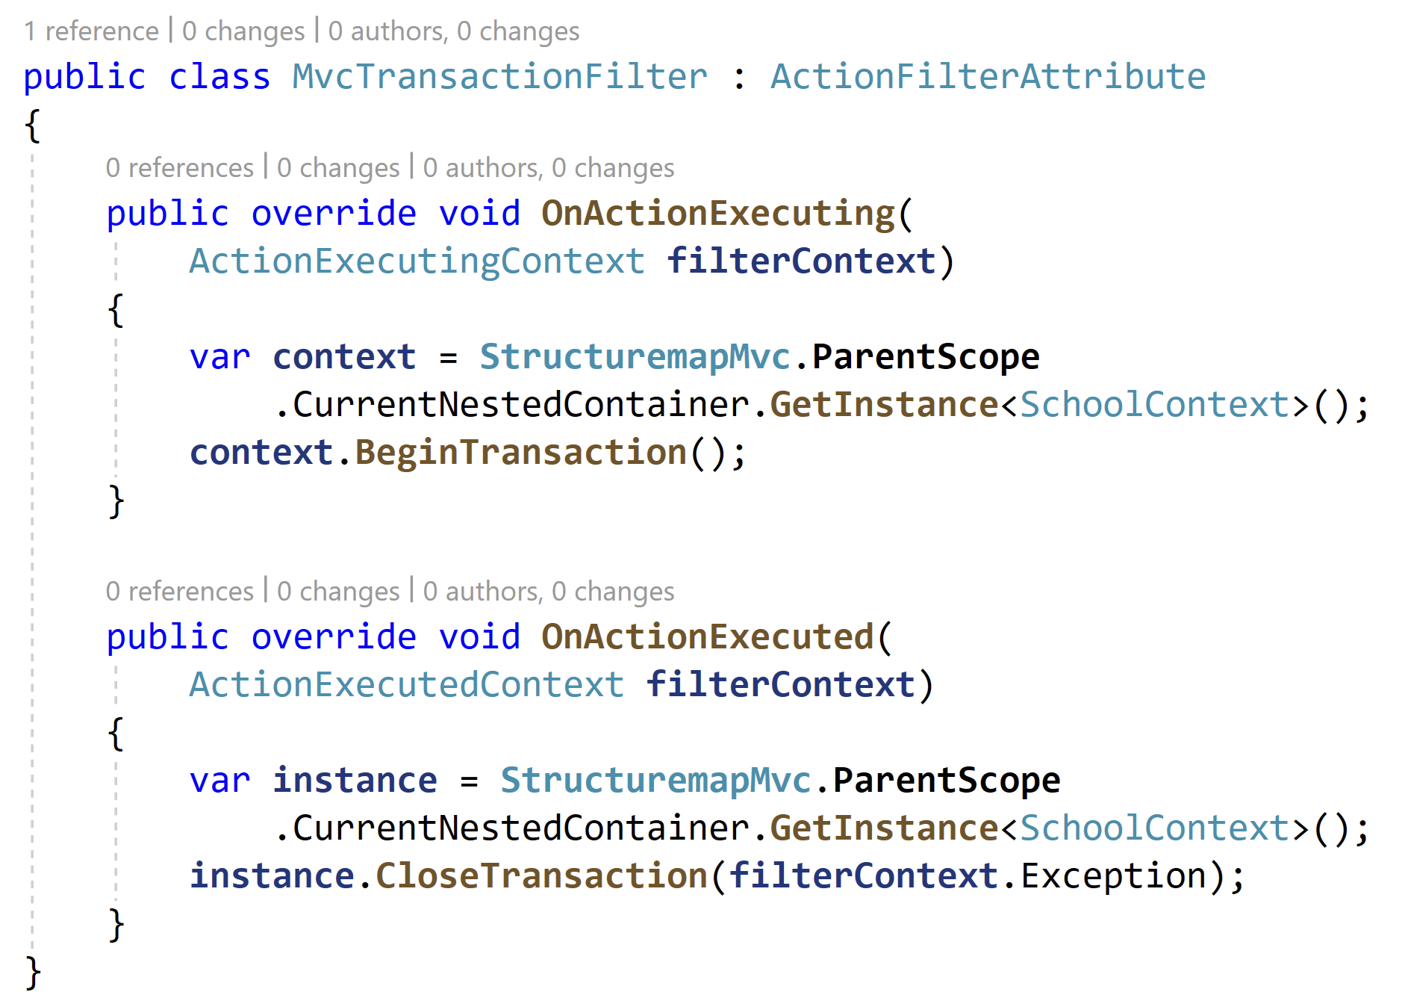
ASP.NET MVC 5 Filter

Slide 65
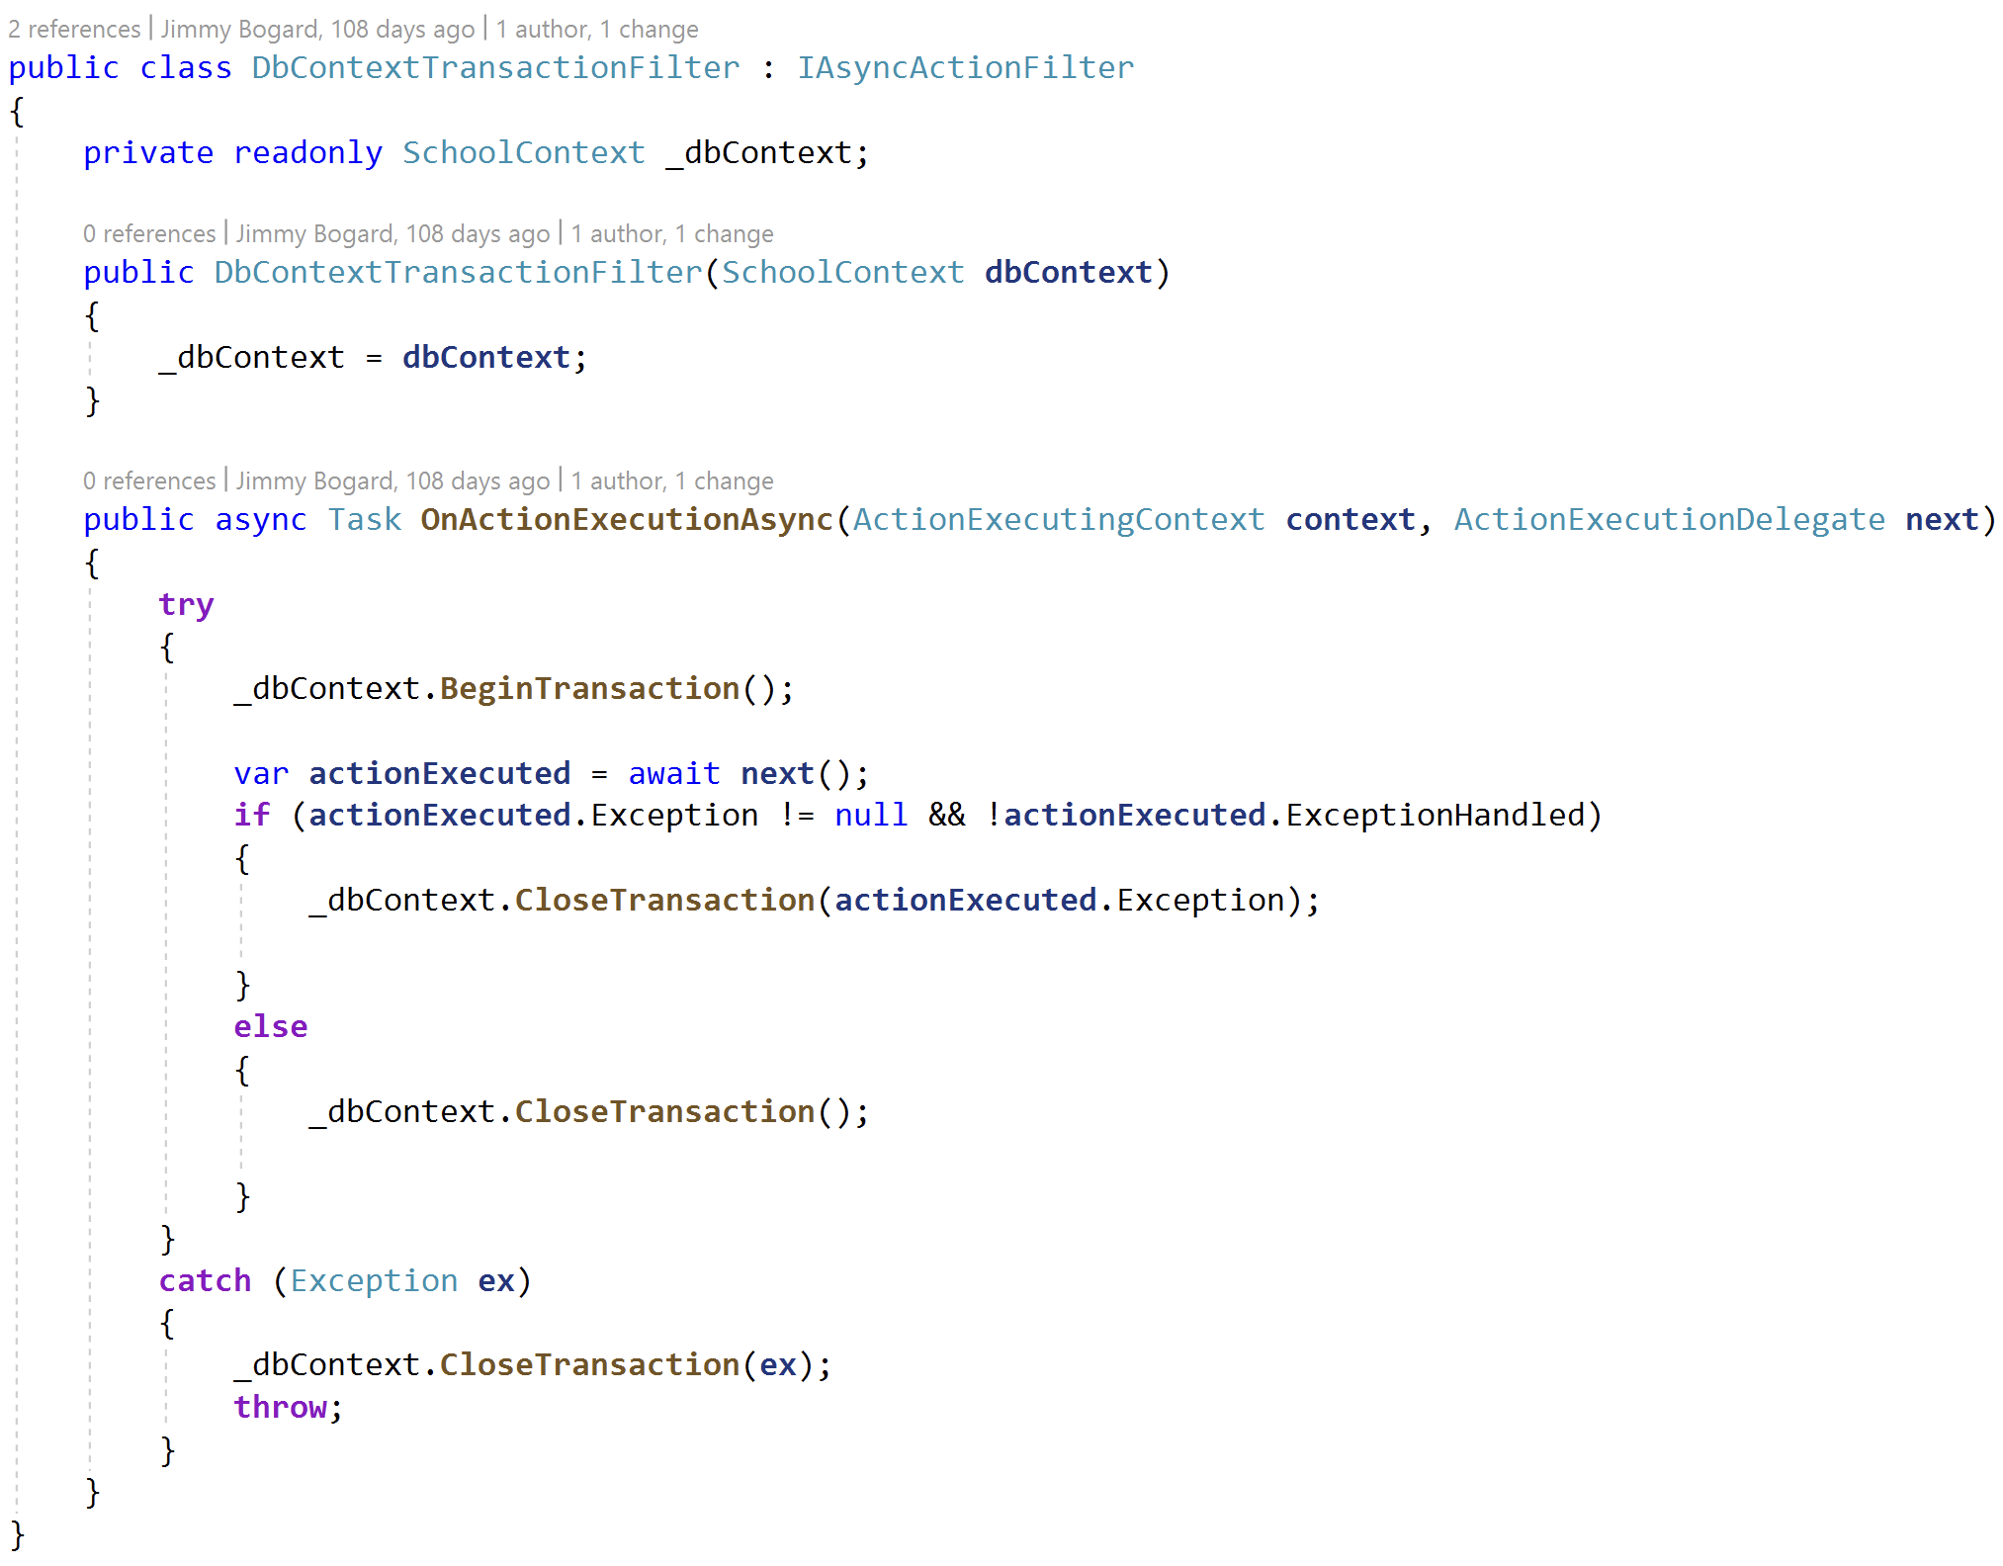
ASP.NET Core Filter Migrated

Slide 66
ASP.NET Identity Migration
Probably the last thing to do
Schema etc. do not match
Completely custom migration code
Good luck!

Slide 67
Turning off the lights
Enable session on ASP.NET Core, disable on ASP.NET MVC 5
Remove all remaining controllers and HTTP endpoints in MVC 5
Disable remote authentication, session in ASP.NET Core
Remove any shims for bridging MVC 5
Monitor for any traffic in MVC 5 application
Remove the MVC 5 application from code, pipelines, and deployments

Slide 68
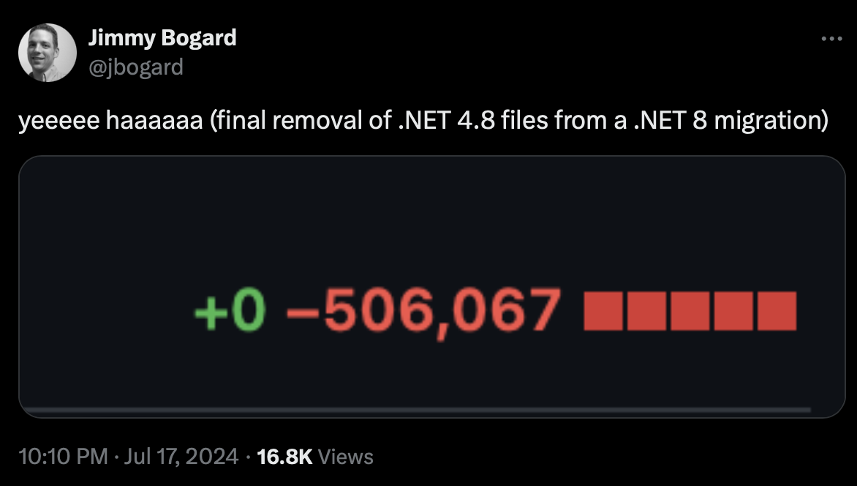
Turning off the lights

Slide 69
Parting Thoughts
Incremental migration minimizes risk with small, verifiable deployments
Except for WebForms
System.Web Adapters enables incremental migration with YARP
There will always be something unique but overcomable
Avoid architectural “improvements” and focus on lift-and-shift

Slide 70
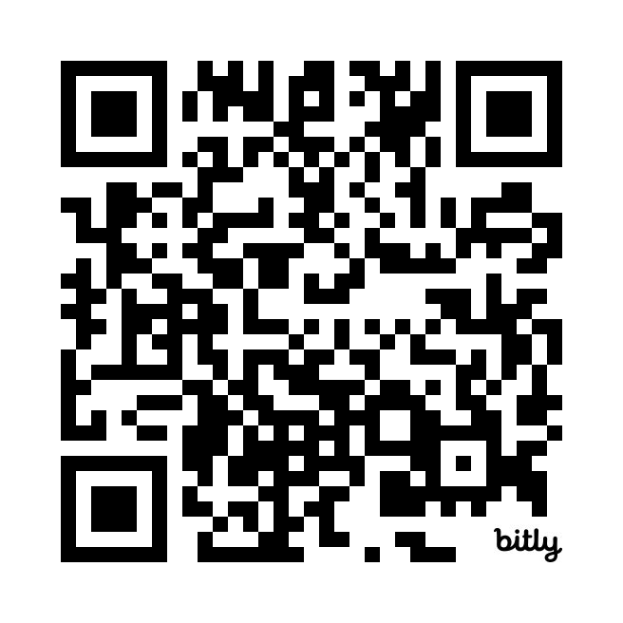
Tales from the .NET 8 Migration Trenches
DDD with Vertical Slice Architecture Training
Oct 21st-23rd in Munich
Dec 10th-12th in Milan
20% discount code Community20

Slide 71
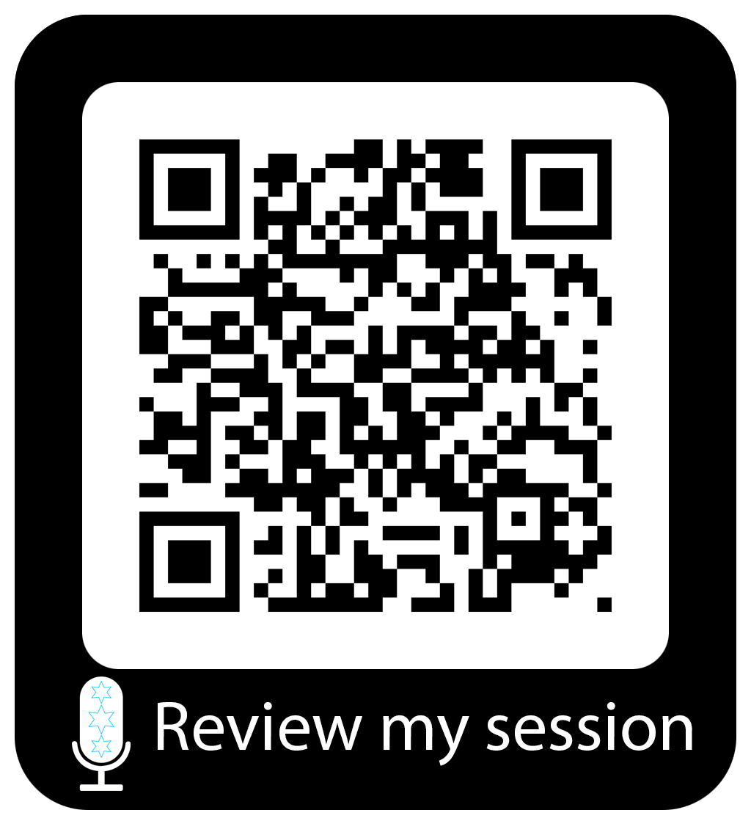

Slide 72
Tales from the .NET 8 Migration Trenches
Jimmy Bogard
@jbogard
github.com/jbogard
jimmybogard.com
github.com/jbogard/presentations

